Slide 1

CAKE Presents PIE
By: Colin Harrison, Christian McMurtrie, Timothy Nakhisa, and Zachary Rivera
Notes:
Introductions: Hi my name is ...
Colin: ... and we make up the CAKE group. We are working on a website that we plan to call PIE.

Slide 2
Introduction
CAKE Group (Computer Applications Knowledge and Experience)
Colin Harrison: Documentation/Dev
Christian McMurtrie: Research/Dev
Tim Nakhisa: Version Control Manager/Dev
Zac Rivera: Scrum Master/QA
Notes:
Colin: CAKE stands for Computer Applications Knowledge and Experience and PIE is an acronym for Personal Interactive Expeditions. We have been working with our client Dr. Yvonne Chueh and our faculty mentor Dr. Ed Lulofs to develop a website that will aid the elderly community that is facing social isolation. This site will promote social activities and outings by allowing members to easily plan activities with other members and possibly, in the future, with volunteers and donors. The simple design should allow easy navigation of the site, easy-to-use scheduling tools, and more.

Slide 3
Real World Application

Slide 4
Architectural Design
Notes:
Our team website was created using a free website editor called wix. All images are royalty-free. The "About" section explains who our group is, what we are working on, and why. The "Project" tab has a brief explanation of our project. It also has a drop down menu that is activated by hovering over "Project". This allows you to view the "Agendas" tab, which shows our client, faculty mentor, and group meetings. The "Repository" tab includes a link our team's repository, links to individual sections of the repository, and a list of past commits. Under the "Scheduling" tab you can see what each of the team members is currently working on as well as lists of major upcoming tasks and completed tasks. There is also a list of "forseen difficulties" that shows some possible problems that we may run in to over the course of the project. Finally, the contact tab contains pictures of each of our group members, our current roles, and some of our contact information. The message box below is linked to our group gmail account, so any messages sent will be accessible by any member of the group.

Slide 5
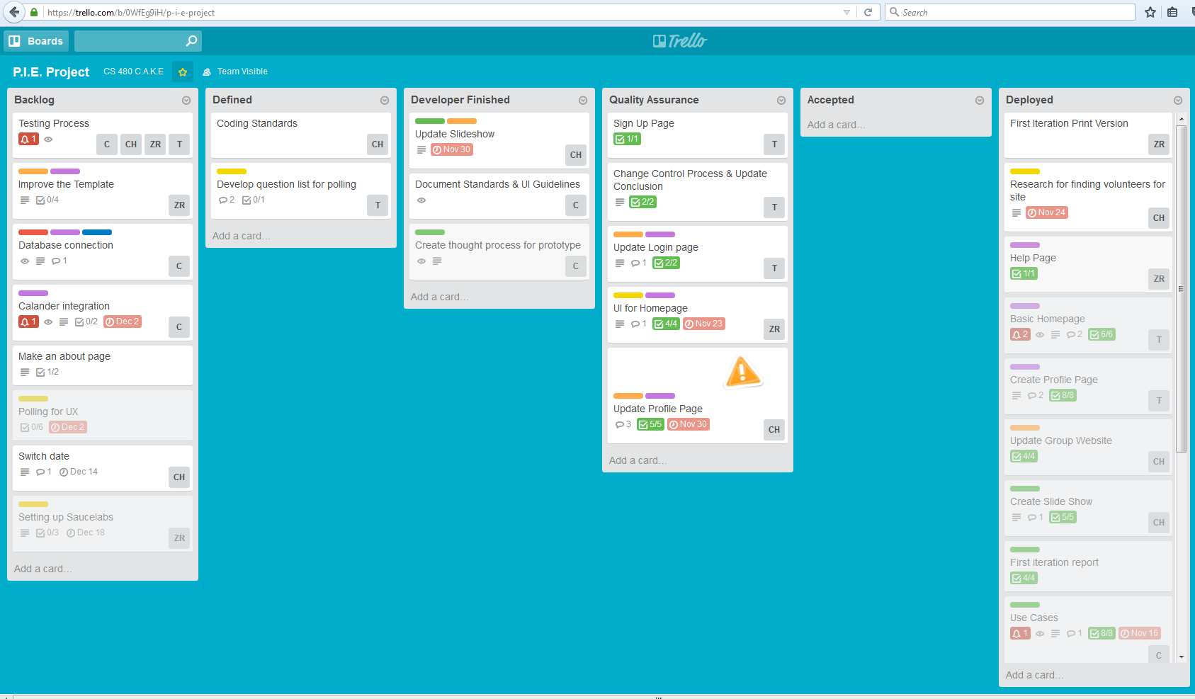
Module design

Slide 6
Module Example
Insert example

Slide 7
Development Strategy

Slide 8
User Interface Rules
Demonstration

Slide 9
First Testing Phase

Slide 10
Second Testing Phase

Slide 11
Demonstration

Slide 12
Conclusion
PIE is a site to promote healthy social activities for the elderly
Completed tasks:
Storing user information in a database​
Creating an easy-to-navigate interface​
Future tasks:
Creating a calendar to organize activities
Hosting the website

Slide 13
QUESTIONS?

